Slide 1
Group 02-04-02
CG1112 ENGINEERING PRINCIPLES AND PRACTICE II
Project: Vincent to the Rescue
A0173378U
A0172069B
A0177400M
A0170832J
A0167038B
Hu Yidi
Wang Jiannan
Li Jiawei
Lim Jit Wei
Liu Tianhang

Slide 2
Once upon a time…

Slide 3
The Monkey King is trapped under Five Fingers Mountain

Slide 4
The monk wants to rescue the Monkey King, his apprentice, but it is very hard for him to achieve that…

Slide 5
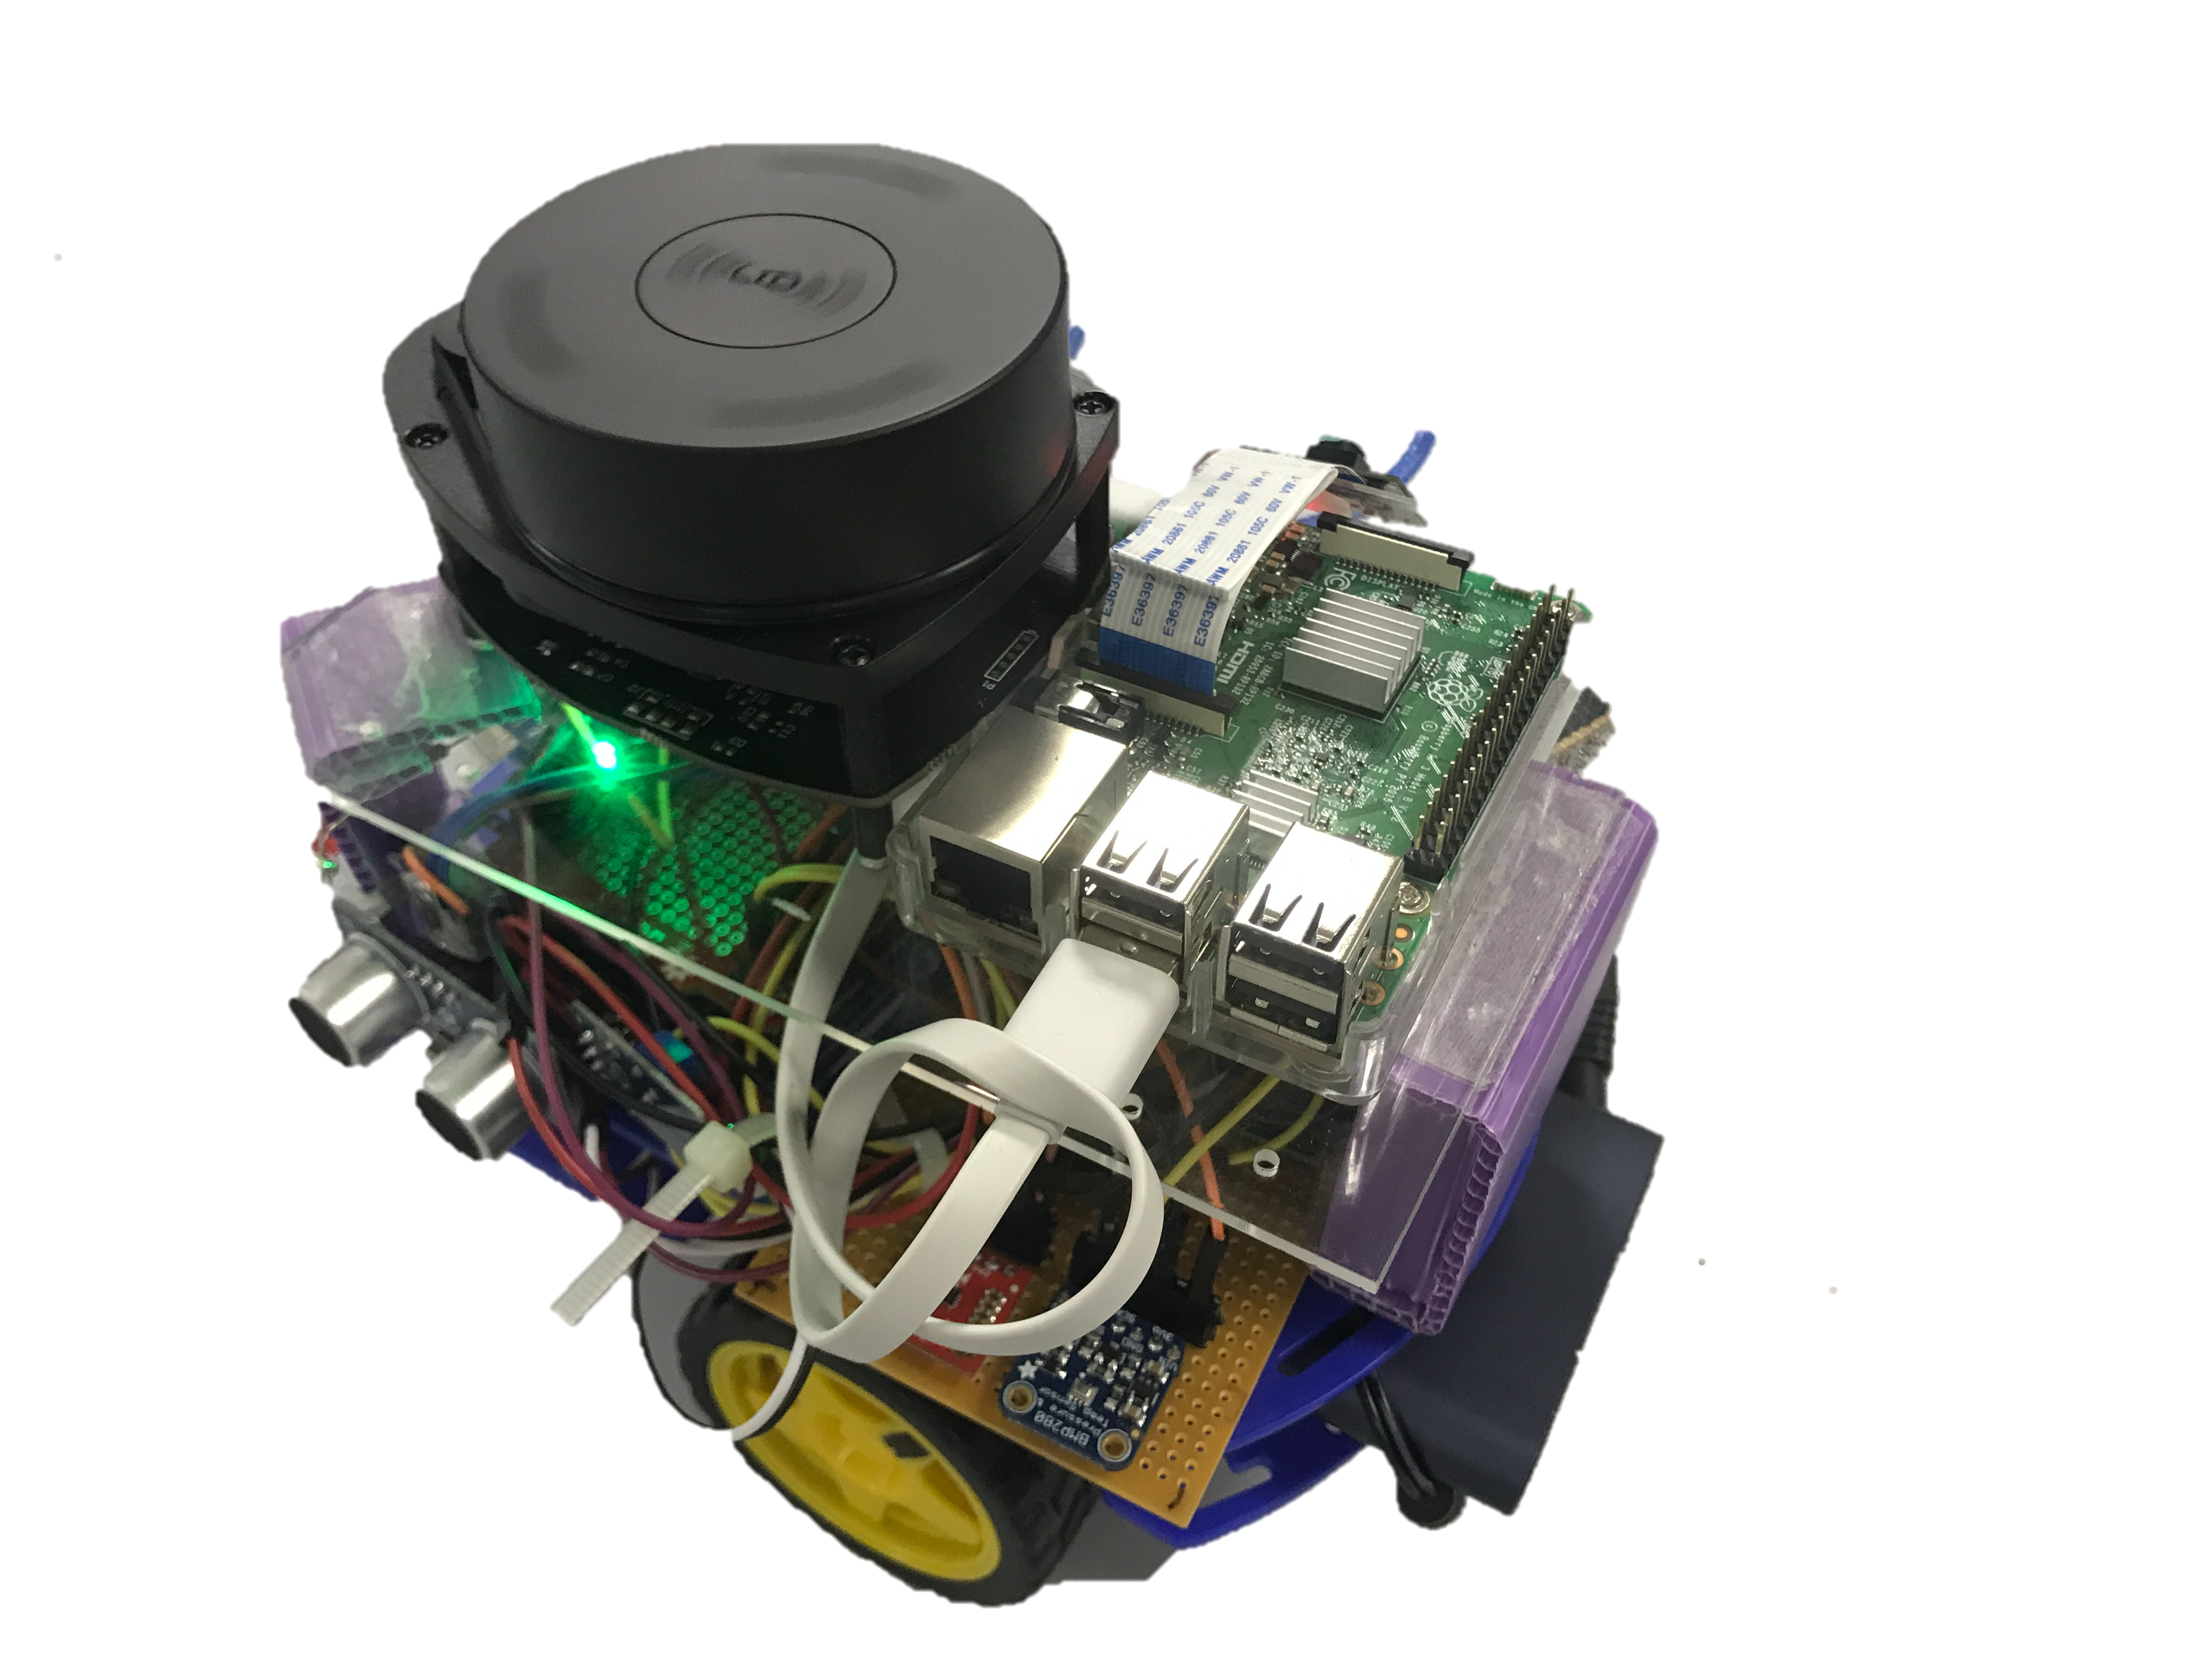
The monk asks for Buddha’s help, and then Buddha gives him Vincent from the Great Land of Technology !

Slide 6
In the Great Land of Technology (aka modern world)
Disasters like earthquakes and explosions can cause great losses. Rescue missions in those dangerous environments are inaccessible for humans.

Slide 7
2015 China Tianjin Explosion
173 lives lost
800 injured
6.9 billion RMB economic loss
110 rescue team members lost

Slide 8
With the advancement of technology…
Solutions such as rescue robots have been developed to perform rescue missions

Slide 9
Vincent
functionality
System architecture
Algorithm design
Hu Yidi
Wang Jiannan
Li Jiawei
Lim Jit Wei
Liu Tianhang

Slide 10
Let me tell you its functionality…
What can Vincent do?
Before using Vincent to rescue his apprentice, the monk has a few questions to ask…

Slide 11
Vincent is a rescue robot
Navigate through an unknown area
Mark current locations
Backtrack to origin point through the same route
Stop and light up LED at marked locations
Monitor and report environmental variables, like temperature and pressure
Take photos of surroundings

Slide 12
Vincent
functionality
System architecture
Algorithm design
Hu Yidi
Wang Jiannan
Li Jiawei
Lim Jit Wei
Liu Tianhang

Slide 13
Let me tell you about the system architecture…
How is Vincent made?
Before using Vincent to rescue his apprentice, the monk has a few questions to ask…

Slide 14
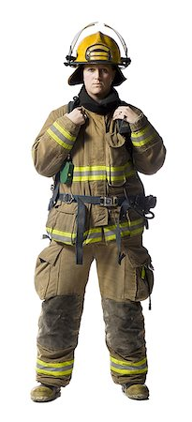
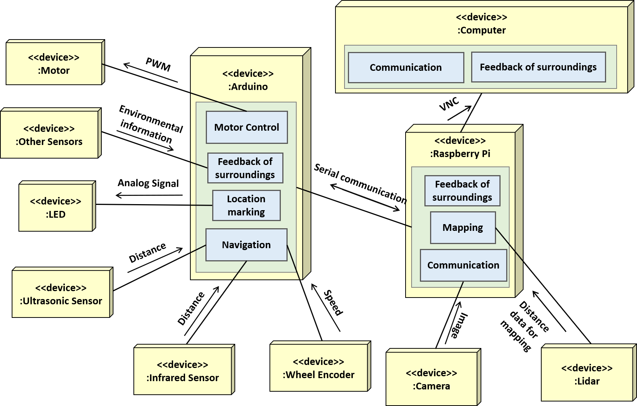
OUR SYSTEM ARCHITECTURE: If Vincent is a human…
Vincent
Notes:
So I’ll be taking over from here to introduce to you regarding the system architecture of our robot Vincent. Here is a block diagram of it. At the center we have raspberry pi as our computer and Arduino uno as our microprocessor in use, operator’s computer sends commands and receive data from the Raspberry pi . We also have multiple distinct functional units such as different sensors, Lidar, Camera unit and telecommunication unit, to perform different functions for the Vincent robot. Some are connected to Pi and some to Arduino. If you are to treat the whole robot system as an actual rescue specialist, a human being, then these different components can all be matched to the respective parts of the human body that enables the whole human system to perform his work. Let’s go through them one by one.

Slide 15
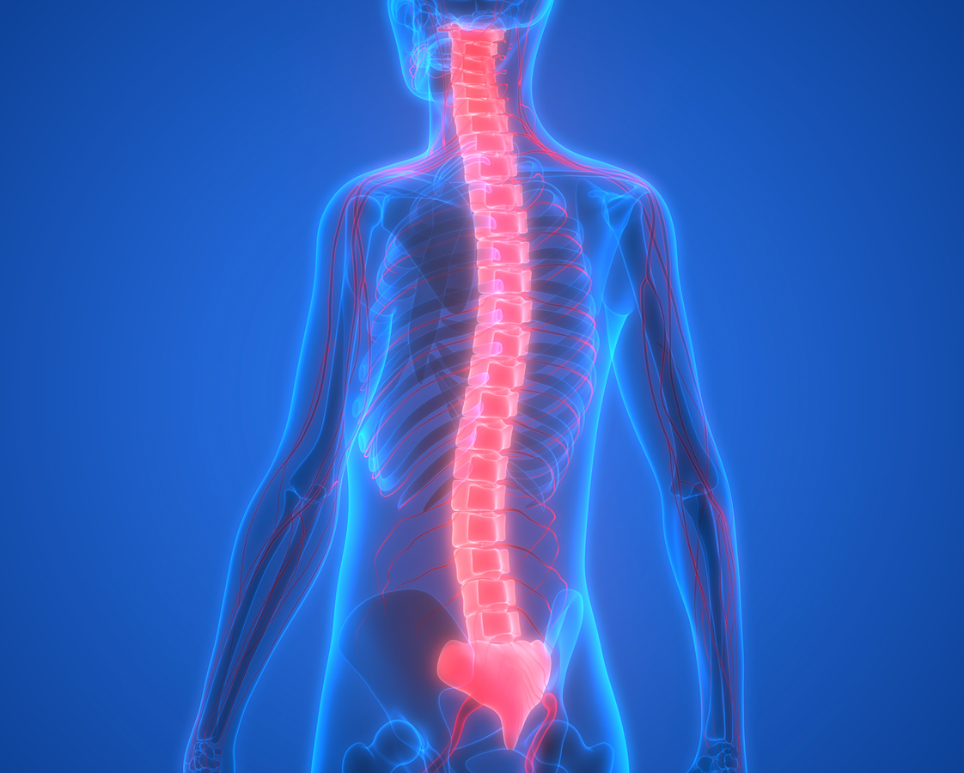
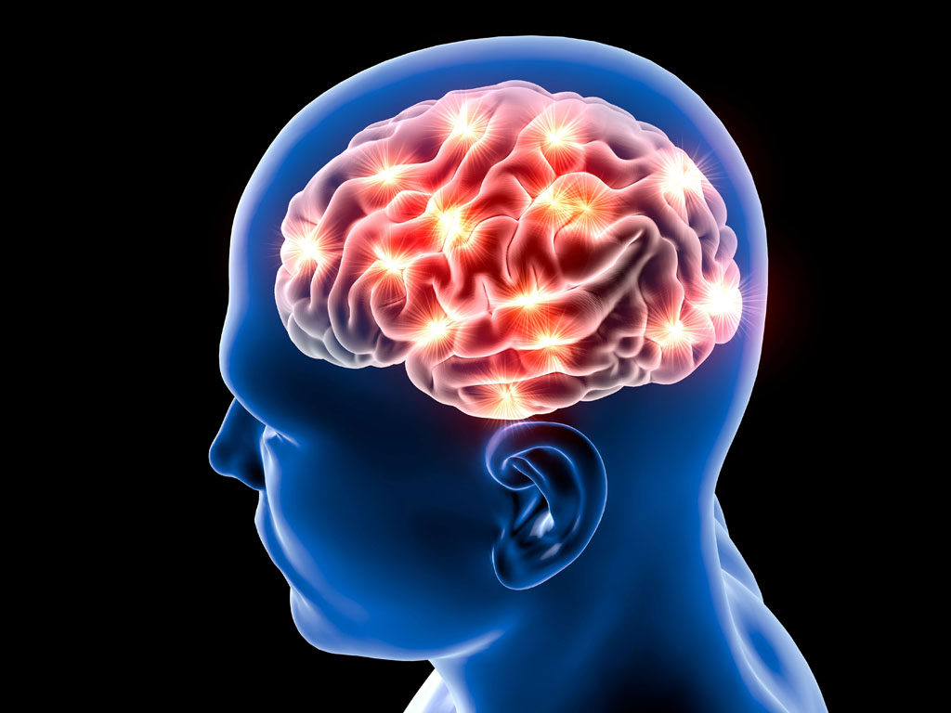

Vincent is using Raspberry Pi and Arduino as Brain and Spine
<<device>>
:Motor
PWM
<<device>>
:Arduino
<<device>>
:Computer
<<device>>
:Other Sensors
Motor Control
<<device>>
:Raspberry Pi
Environmental information
Feedback of surroundings
Feedback of surroundings
VNC
Communication
Analog Signal
Serial communication
<<device>>
:LED
Location marking
Mapping
Feedback of surroundings
Navigation
Communication
Distance
<<device>>
:Ultrasonic Sensor
Speed
Distance data for mapping
Central organ of the nervous system
Overall in charge
Image
Distance
Subordinary neural center of the central nervous system
Receive and transmit pulses from and to the sensory units
<<device>>
:Wheel Encoder
<<device>>
:Lidar
<<device>>
:Infrared Sensor
<<device>>
:Camera

Slide 16
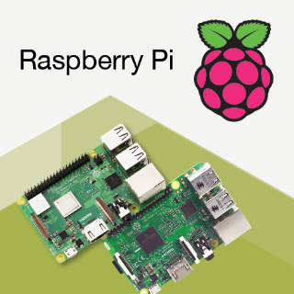
Raspberry Pi 3 (brain of Vincent) runs SLAM & Arduino IDE and communicate with computer
<<device>>
:Raspberry Pi
Feedback of surroundings
Mapping
Communication

Slide 17
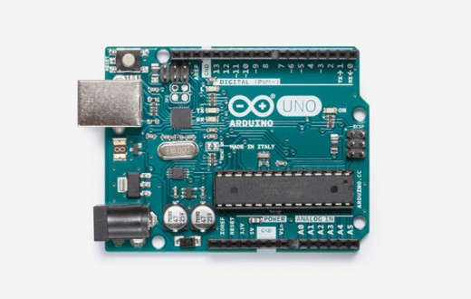
Arduino (spinal cord) takes charge of motor control and connection with sensors
<<device>>
:Arduino
Motor Control
Feedback of surroundings
Location marking
Navigation

Slide 18
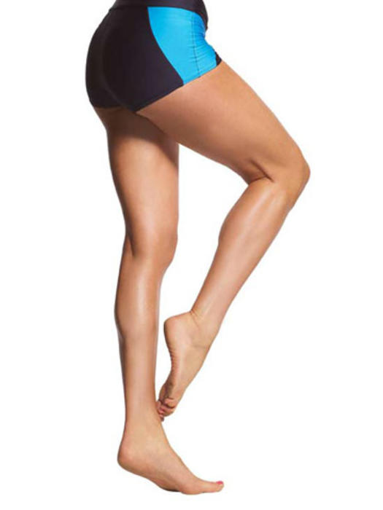

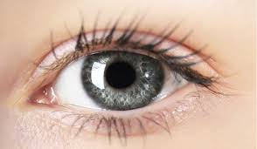

Motors, sensors and Lidar are functional parts of the body
<<device>>
:Motor
PWM
<<device>>
:Arduino
Functional Units
<<device>>
:Raspberry Pi
<<device>>
:Other Sensors
Motor Control
Feedback of surroundings
Environmental information
Serial communication
Feedback of surroundings
Mapping
Analog Signal
<<device>>
:LED
Location marking
Communication
Distance data for mapping
Navigation
Distance
Image
<<device>>
:Lidar
<<device>>
:Ultrasonic Sensor
Speed
<<device>>
:Camera
Distance
<<device>>
:Wheel Encoder
<<device>>
:Infrared Sensor

Slide 19
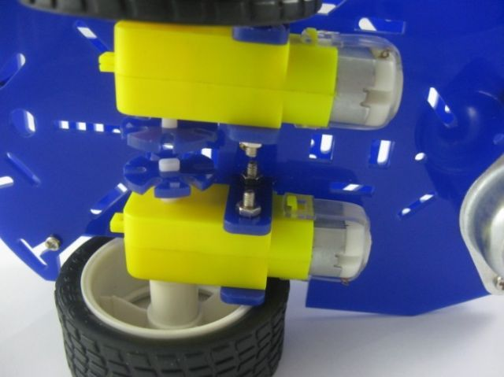
Motors are legs of Vincent that drives the robot
<<device>>
:Motor
Control
DC3V-6V TT gear smart motor
Notes:
Magician chassis gearmotor with a 48:1 gear
DRV-8833 Dual Motor Driver Carrier

Slide 20
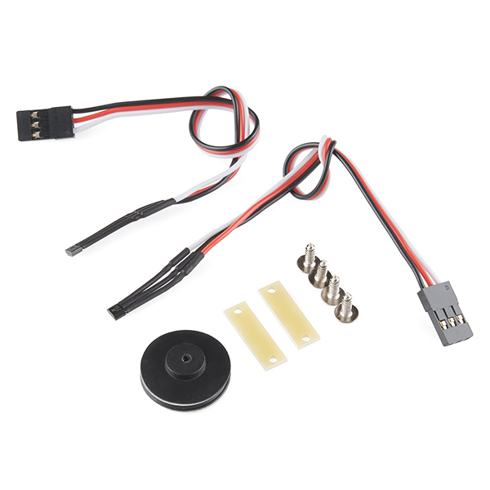
Wheel encoders “sense” and record distance travelled
<<device>>
:Wheel Encoder
Mount
Dagu simple hall-effect wheel encoder kit RS030
Notes:
Hall-effect wheel encoder

Slide 21
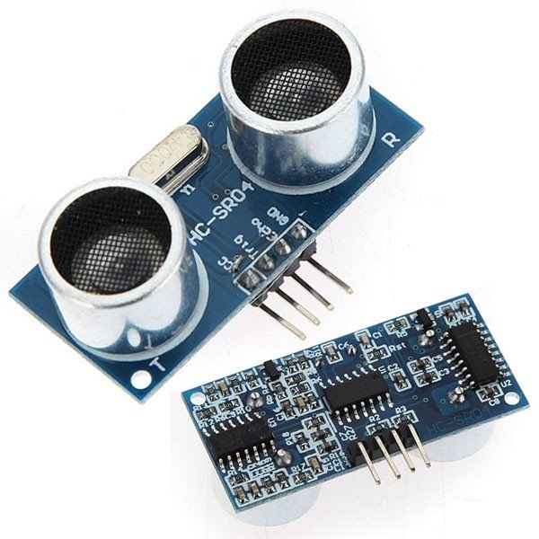
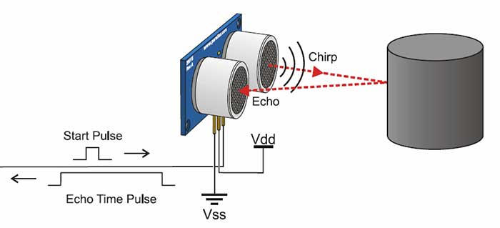
Ultrasonic sensors keep checking distance from side walls to prevent collision
<<device>>
:Ultrasonic sensor
Ultrasonic sensor module HC-SR04
Notes:
Ultrasonic Sensor

Slide 22
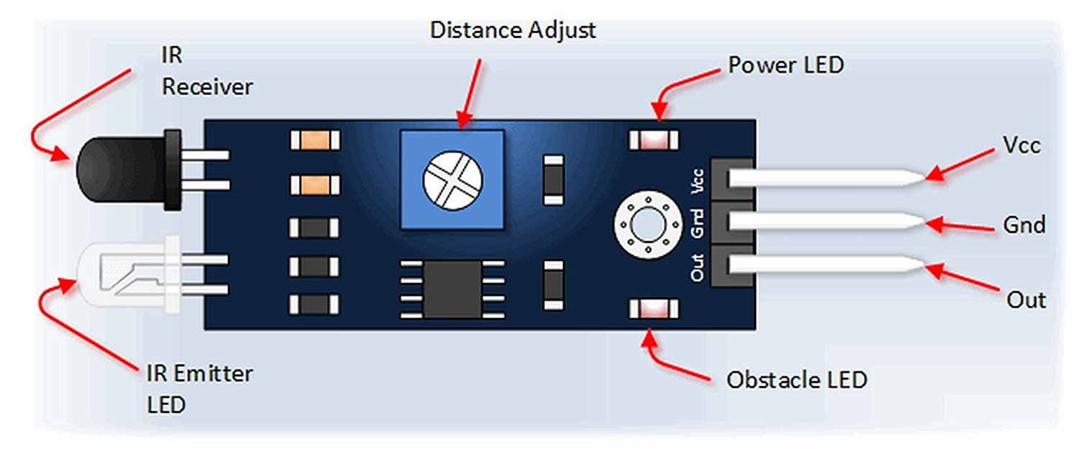
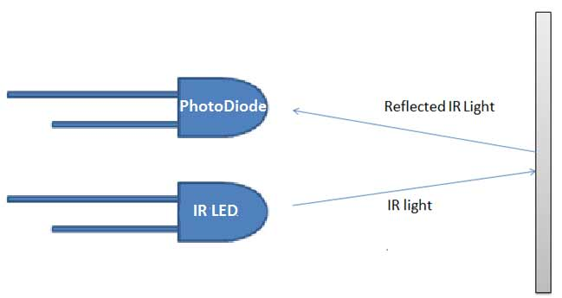
Infrared sensor keeps checking distance from front wall to prevent collision
<<device>>
:Infrared sensor
Infrared sensor
Notes:
IR Sensor

Slide 23
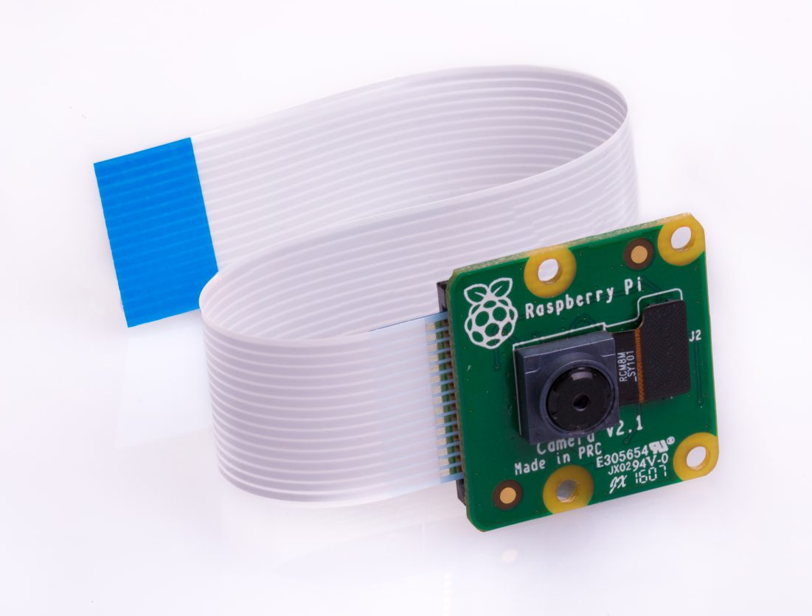
The camera captures images of its surroundings
<<device>>
:Camera
Raspberry Pi camera board
Notes:
Raspberry Pi Camera

Slide 24
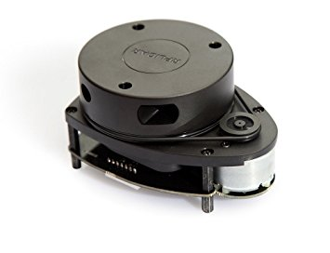
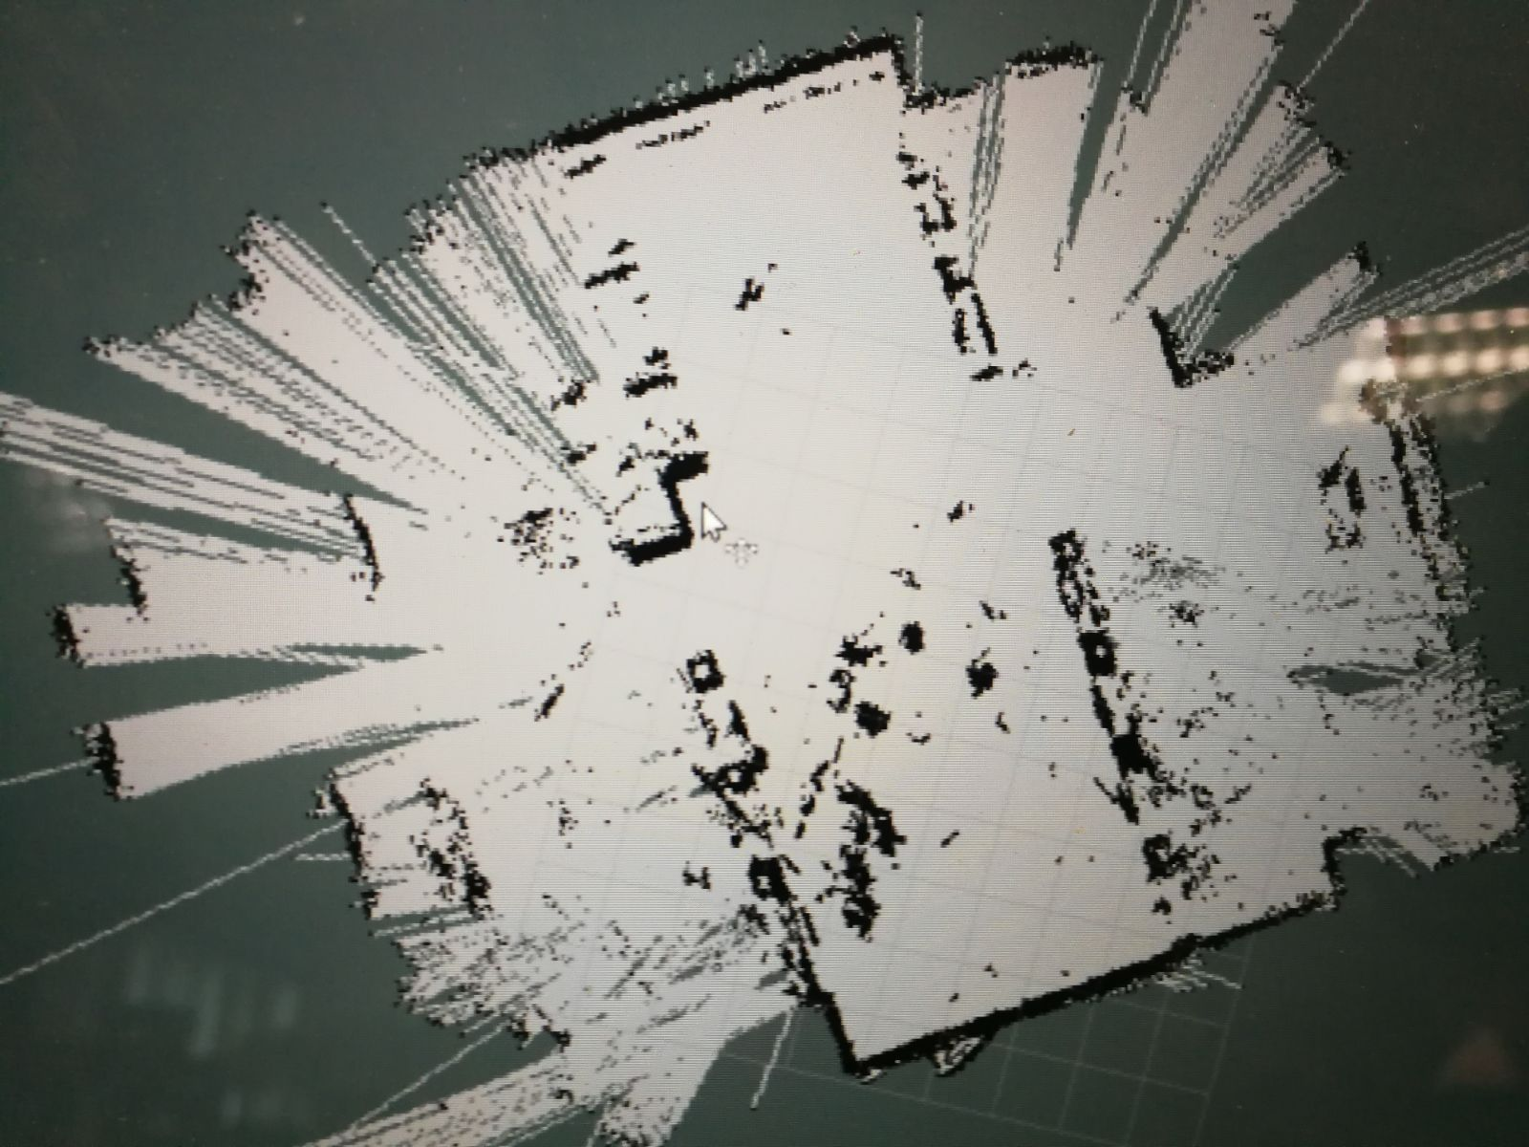
Lidar, with the help of Hector SLAM, maps the environment
<<device>>
:Lidar
RPLIDAR A1 by SLAMTECH
Mapping result of part of the DSA lab
Notes:
Lidar

Slide 25

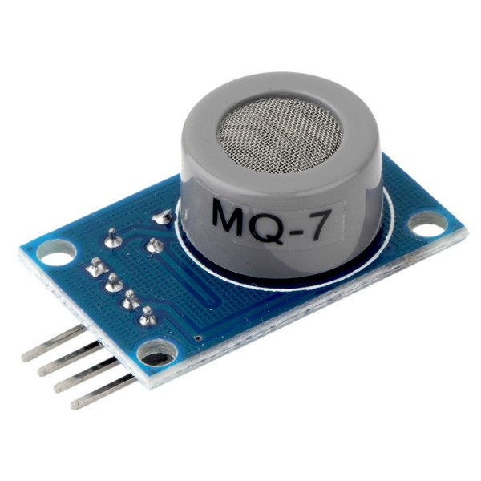
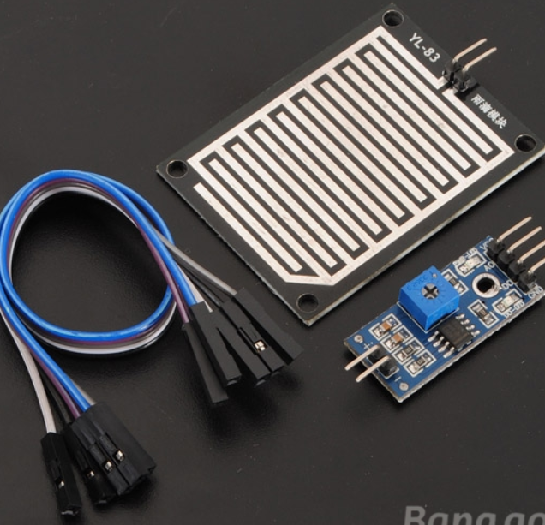
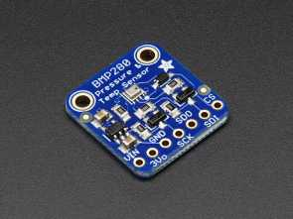
Other sensors showed below assist in collecting environmental information
<<device>>
:Other Sensors
BMP280 Barometer pressure and altitude sensor
Carbon monoxide sensor MQ7
Raindrop sensor
Notes:
Carbon monoxide sensor
Raindrop sensor
BMP280 barometer pressure and altitude sensor
// Oxygen level sensor

Slide 26
Vincent
functionality
System architecture
Algorithm design
Hu Yidi
Wang Jiannan
Li Jiawei
Lim Jit Wei
Liu Tianhang

Slide 27
Let me tell you about the algorithm design…
How does Vincent work?
I don’t want it to hurt my monkey…
Before using Vincent to rescue his apprentice, the monk has a few questions to ask…

Slide 28
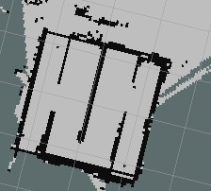
Vincent is tele-operated in phase 1.
Part A: Map with LIDAR and hector SLAM
Part B: Navigate and mark location using the map
Part C: Store commands on a SD card

Slide 29
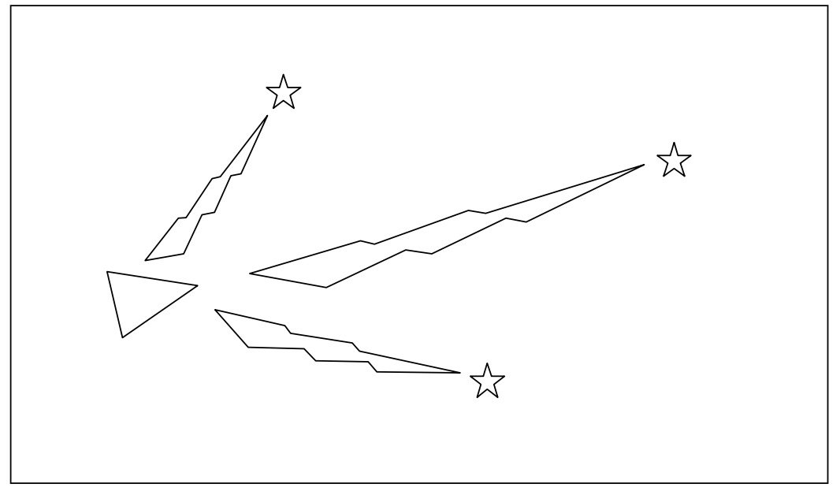
Hector SLAM
Use Lidar to extract landmarks

Slide 30
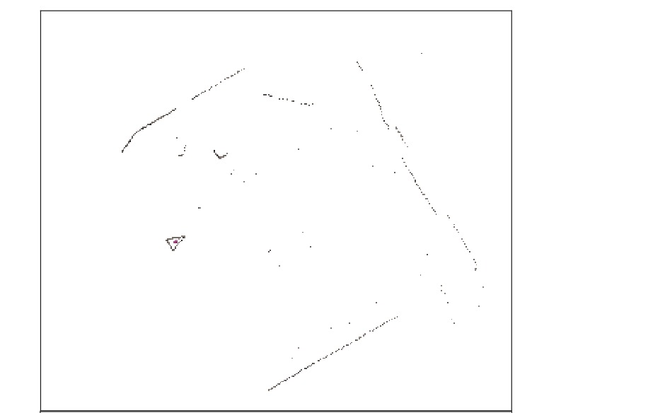
Hector SLAM
As Vincent moves, it compares current landmarks
with previously observed landmarks

Slide 31
Hector SLAM
Then it aligns the landmarks to produce a map

Slide 32
Problem
Hector SLAM uses too much processing power of PI
PI overheats
PI restarts

Slide 33
Solution
Run the command “cpulimit -e hector_mapping -l 80” to limit the CPU usage to 80 %

Slide 34


Navigate and mark locations
command

Slide 35
Store commands on SD card
f 20 80
l 10 80
f 10 80
l 10 80
f 20 80
f 20 80

Slide 36
Phase 2 is autonomous backtracking
f 20 80
l 10 80
f 10 80
l 10 80
f 20 80
f 20 80
180-degree turn
Read data from SD card

Slide 37
Directions will be reversed

Slide 38
Vincent will stop and blink at marked locations

Slide 39
Sudden events during backtrack
END

Slide 40
Sudden events during backtrack
END

Slide 41
Rational of using SD card
Prevent data loss!
1. PI is unstable with SLAM
2. serial communication between Arduino and PI is unstable

Slide 42
Vincent
functionality
System architecture
Algorithm design
Q & A
Any question before I use Vincent to save my monkey?
Hu Yidi
Wang Jiannan
Li Jiawei
Lim Jit Wei
Liu Tianhang

